Slide 1
Compliance & Privacy
For internal use only. Not for distribution outside of UVA Community Health. Last update: 09.2026

Slide 2
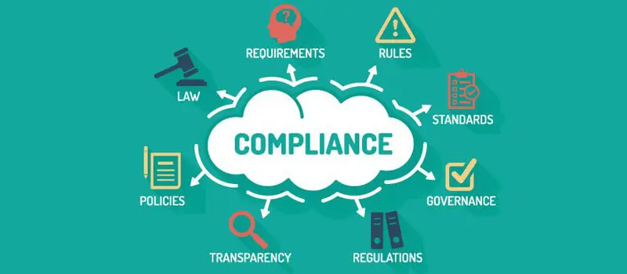
Compliance: Doing the Right Thing, the Right Way, At the Right Time, Every Time.
In health care, that means following:
  Federal and state laws
  Regulatory requirements
  UVA CH policies and procedures
These laws, guidelines, and policies exist to protect patients, employees, and the hospital.
Notes:
Compliance is essentially doing the right thing even when no one is watching. In healthcare, that means following federal and state laws, regulations , and CH policies and procedures. It’s important that we protect not only our patients, but each other and the organization.

Slide 3
Compliance Code of Conduct
Accountability Stewardship Professionalism Integrity Respect Empathy
The UVA Health Code of Conduct establishes the ethical and
legal standards that guide the operations of UVA Health and
UVA Community Health.
It applies to everyone employed by, representing, or doing business with UVA Community Health, including team members, leaders, medical staff, allied health professionals, board members, vendors, and business partners.
The Code requires each of us to uphold the highest standards of ethical and professional conduct, act responsibly and with integrity, and comply with the laws, regulations, policies, and procedures that govern our work.
Know the Code: Find the Code of Conduct on the UVA CH Intranet and on the UVA Health website at https://www.healthsystem.virginia.edu/codeofconduct/
Notes:
The Code of Conduct is a set of guidelines that outlines the ethical and legal standards that all team members, as well as anyone doing business with UVA or UVA Community Health, must follow. It ensures that everyone within the organization acts responsibly, maintains integrity, and complies with laws and regulations. Both UVAH and UVACH have aligned our Code of Conduct and it can be found on both the UVACH intranet page and on the UVA Health website

Slide 4

Potential Compliance issues that must be reported
You are often the first to see when something is not right. Recognizing and reporting concerns allows us to address issues early and protect our patients, team members, and organization.
• Billing (services not rendered, duplicate billing, failure to report overpayments)
• Falsifying certifications on records to maximize payments
• Unlawfully giving healthcare providers inducements in exchange for referrals for services
• Conflicts of interest
• Misuse of property, technology, and confidential information
• Inappropriate business courtesies and gifts
• Bribes, Kickbacks, Theft or Fraud
• Inappropriate medical record alteration and destruction
• Sexual harassment
• Discrimination
• Violations of patient rights
• Health, safety, and environment issues
• Failure to adhere to professional standards of practice
• Potential criminal violations
If you are ever on the fence about reporting a concern,
let us take that burden off your shoulders.
Anonymous reporting is available.
Notes:
Potential Compliance Issues that must be reported. Ranging from billing issues and conflicts of interest to bribes and discrimination. If something feels ‘off’ but you’re not sure, report it, let us take that burden off your shoulders and investigate your concerns.

Slide 5

Protected Health Information (PHI)
PHI is generally defined as: Any information that can be used to identify a patient –whether living or deceased– that relates to the patient’s past, present, or future physical or mental health or condition, including healthcare services provided and payment for those services.
Note: This includes PHI of a deceased individual for period of 50 years following the death of that individual.
PHI can be written, spoken or electronic.
PHI is not limited to clinical information
Any of the following are considered identifiers under HIPAA
Patient name
Address
Telephone number
Fax number
Social Security number
Vehicle identifier
E-mail address
Web URLs and IP address
Dates (except year)
Any unique number, code, or characteristic that can be linked to an individual.
Names of relatives
Full face photographs or image
Healthcare record number
Account number
Biometric identifiers (fingerprints or voiceprints)
Device identifier
Health plan beneficiary number
Certificate/license number
Ask yourself: Could some figure out who it is?
Notes:
Protected Health Information, referred to as PHI, is generally defined as any information that can be used to identity a patient whether living or deceased. A deceased individuals information is protected for a period of 50 years.
PHI can be written, spoken or electronic. It is every Team Member’s responsibility to know and understand what should be protected and how to protect that information. Ignorance of the law is no excuse.
NOTE: PHI is not limited to clinical information (medical record, diagnosis, meds, etc). During investigations we have heard from team members comments that they didn’t think accessing a demographic page, with name and address, was PHI. It includes name, dob, and other demographic information. So you cannot even access demographic information without an assigned job duty.
Ultimately, the HIPAA regulations use this as a catch all: any number, code or characteristic that can be linked to an individual.

Slide 6

Team Members cannot access PHI (written, spoken, or electronic) unless required to perform their job duties.
Notes:
NOTE on coworkers who are patients:
Coworkers who are patients, require the same privacy protection.
If your coworker is also a clinic patient, and during the course of your duties you receive information about a diagnosis or test results, you cannot share that information with anyone unless it is required to complete your assigned job duties. Even if you are very concerned.
You cannot access a coworker’s record to look up an address for a get well card or party invitation.
You cannot access the record of a friend who just had a procedure done.
You cannot ask a coworker to look up patient information for you, because you’re not allowed to be in the chart, but they are.
Bottom line, non-negotiable, Team Members cannot access or share PHI (written, spoken or electronic) unless required to perform their assigned job duties.
If you overhear or have incidental access to information during the course of your duties, you are required to maintain the confidentiality of that information.

Slide 7

Protecting PHI:
Verbal Safeguards and Reminders
Discuss/share patient information only with those who need it to perform their job duties.
Beware of ‘gossiping’ about patient information.
Be mindful of who can overhear conversations with patients and their representatives. Lower your voice in public areas/hallways.
Do not discuss patient information outside of work.
Advice from Pippa the HIPAA Hippo:
Before you speak, take a peek. Who can hear you?

Slide 8
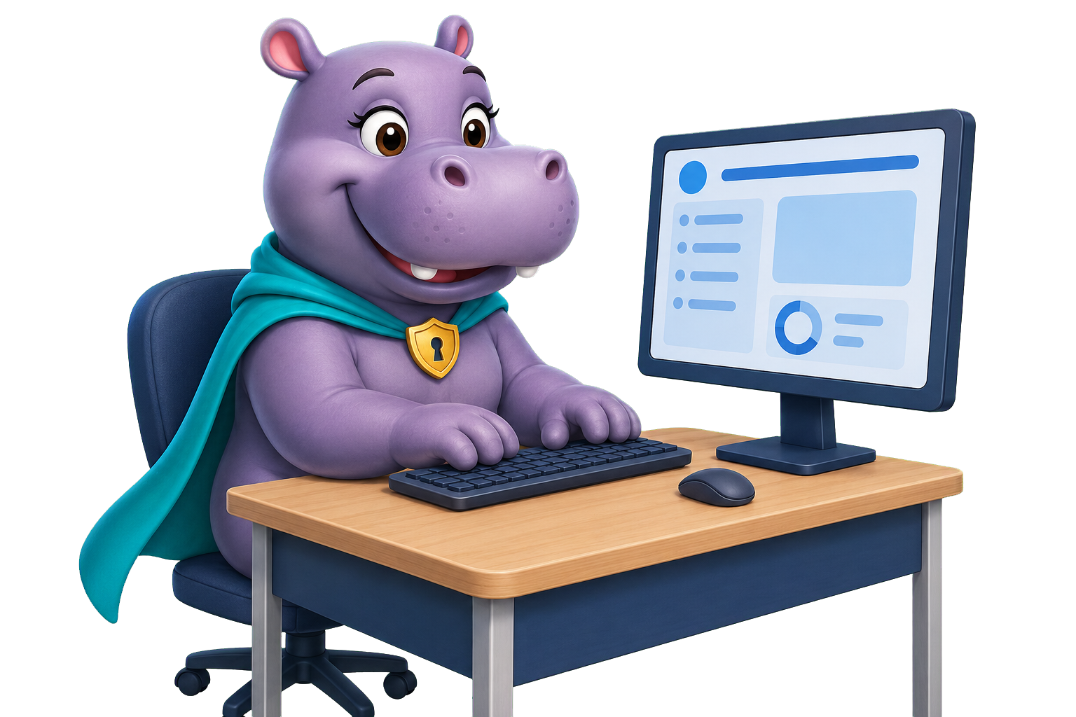
Protecting PHI:
Electronic Safeguards and Reminders
Access patient information only when needed to perform your assigned job duties.
  Templates: Team members should not access templates or patient information, without a job assigned need.
Never access a record because you are curious, concerned, or personally connected to the patient.
Verify that you are in the correct patient’s chart before viewing, documenting, printing, scanning, or sending information.
  Use caution when copying and pasting information between records.
Never share passwords or write them where others can find them.
Lock or log off of your computer whenever you step away.
  Don’t just turn off your monitor
Double-check recipients, attachments, and patient identifiers before sending electronic information.

Slide 9

Protecting PHI:
Paper Safeguards and Reminders
Privacy and Red Rule requirements go hand in hand – always stop and verify before releasing patient information.
Verify the patient’s identity using two identifiers.
Confirm patient information while handling documents (prescriptions, lab orders, after visit summaries, etc)
Remove paper PHI from desks, printers, fax machines, and other areas where it could be viewed or taken.
Store paper records in locked cabinets or secured office areas.
Place PHI that is no longer needed in a locked shred bin—not a regular trash or recycling bin.
Advice from Pippa the HIPAA Hippo:
Highlight the patient’s name and another identifier before faxing, scanning, or releasing.

Slide 10



Protecting PHI:
General Safeguards and Reminders
Never post patient information, photographs, videos, or stories on social media.
If you personally know a patient, step back from the patient’s care or record if possible.
Never text patient information, use approved communication methods.
  Send electronic PHI only through approved methods, such as MyChart.
Do not enter PHI into public AI tools, personal cloud storage, or unapproved applications.
Follow communication restrictions, confidentiality requests, and other privacy indicators documented in the patient’s record.
Never use EPIC to view your own record or look up information for a family member, friend, coworker, or anyone else without an assigned job-related need.
Advice from Pippa the HIPAA Hippo:
Use MyChart to access your own health information.

Slide 11


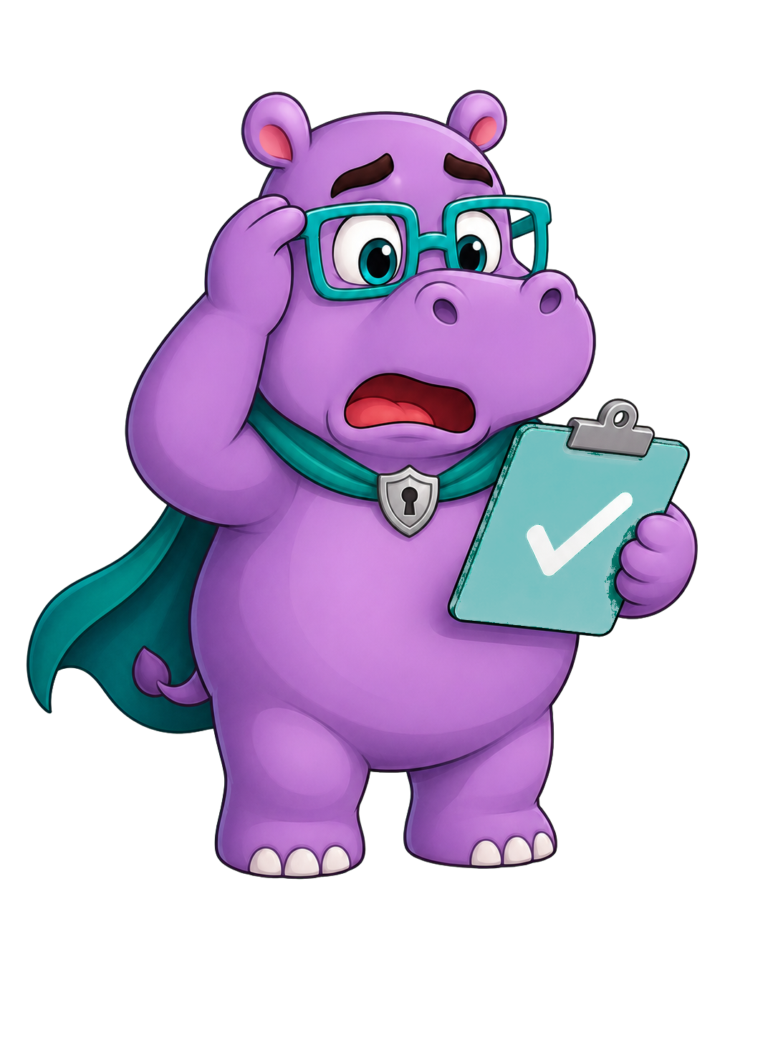
Disclosure/Breach Investigation and Reporting
            Obtain information and facts about the information disclosed
                Material (paper, electronics, CD, etc): we must try to obtain the information
                Email: retract the information if possible
                Signed attestation from person who received the impermissible disclosure
                HIPAA breach notification risk assessment
Consequences of a breach
  Disciplinary action, up to termination
  Notification to patient(s)
  Office of Civil Rights reporting
  Licensed Healthcare Providers – Reporting to licensing board
  (RN, LPN, Physician, anyone licensed in state of VA)
  Fines
  Legal Action
  Jail Time
Notes:
When a disclosure of PHI is identified, you must report it immediately so we can begin our investigation.
If the information is tangible (paper, electronics, CD, etc.) we must try to get that information back. If the patient brings you the information, do not shred or destroy it. We need to review what was disclosed as part of our risk assessment.
If you identify that an email containing PHI was sent to the incorrect recipient, retract the email.
Part of our process is to obtain a signed attestation from the person who incorrectly received the PHI.
We complete a risk assessment to determine if the disclosure qualifies as a breach and if it requires reporting to the Office of Civil Rights.
If we have to report to the Office of Civil Rights, and the team member involved is a licensed provider – RN, LPN, Physician, anyone licensed in the state of VA, we may have to report to your licensing board.
Other consequences include fines, legal action and jail time. Consequences can apply to the team member who breached confidentiality, not just the organization.

Slide 12

Disclosure/Breach Investigation and Reporting
Potential privacy issues that must be reported:
  Misrouted fax, email, letter or bill
  Known or suspected inappropriate access to medical records
  Wrong after visit summary given to a patient
  Posting patient information on social media
  Sharing patient information inappropriately (written, spoken or electronic)
  Known or suspected phishing scams or computer hacking
Notes:
These are some common privacy issues that must be reported. This list is not inclusive – so if you are ever on the fence about reporting, bring it to our attention and let us work through the process.
You always want to proactively report anything that you feel MIGHT be a privacy violation.

Slide 13

Reporting Requirements
As a Team Member of UVA Community Health, it is your responsibility to report disclosures involving PHI to your supervisor and the Compliance & Privacy Department as soon as possible.
Corporate Compliance and Privacy Office
1-877-266-7632 (1-877-COMPOFC) – Direct line to Compliance & Privacy Office
Anonymous Compliance Hotline: 1-877-888-4806
Compliance Email: CommunityHealthCompliance@uvahealth.org
Anonymous Online Reporting: www.UVACommunityHealth.ethicspoint.com
Anonymous Mobile Reporting: www.UVACommunityHealthMobile.ethicspoint.com
This information is available on the UVA Community Health intranet page under the Compliance & Privacy tab, and the UVA CH Code of Conduct
Team members, volunteers, or contractors of UVA Community Health may not threaten or take any retaliatory action against an individual for exercising their rights, raising a concern in good faith, or participating in an investigation or other protected activity.
https://communityhealth.uvahealth.org/complianceprivacy/code-of-conduct/
Equal Employment Opportunity (EEO) and Non-Retaliation Policy
Notes:
Report compliance or privacy concerns immediately to your leader or the Compliance & Privacy department. Following reporting to your leader or Compliance & Privacy department, enter a BeSafe report for tracking.

Slide 14

Feedback/Questions/Concerns?

